Slide 1
Money Transferring
application

Slide 2

Money Transferring
A simple money transferring application allows users to send and receive money electronically. Users can link their bank accounts or credit/debit cards to the app and transfer funds to other users in real-time. The app may also offer features such as transaction history, notification alerts, and security measures such as two-factor authentication. The user interface is designed to be intuitive and user-friendly.

Slide 3

Task - 2
Create various Front End Programs
Draw and design a uniform front end code for calculator
Draw and design a interactive front end code for text-editor
Evaluation Metric:
100% Completion of the above tasks
Learning Outcome
Get to know about concepts of project bucketing
Knowing about various frontend development framework like angular, vue,react
Know about various react topics like components, props, state, life cycle etc.

Slide 4
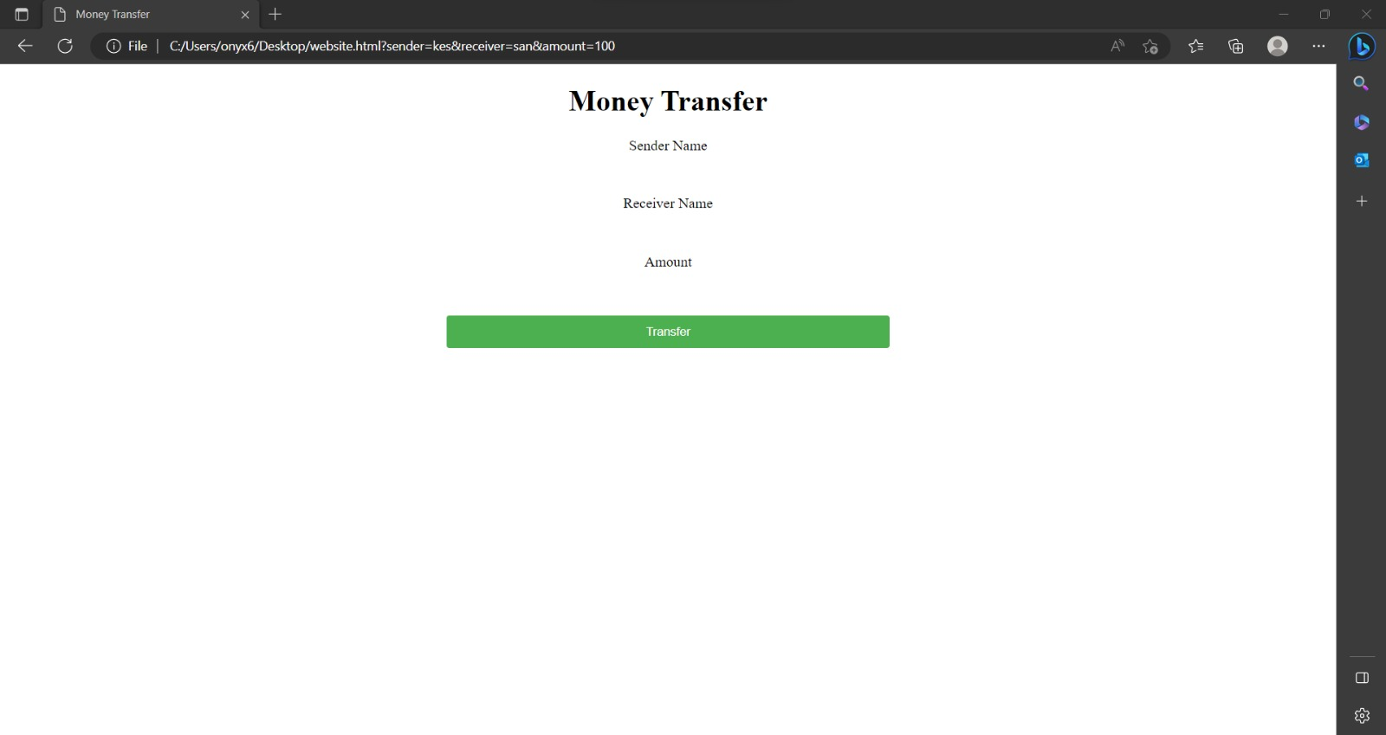
output :

Slide 5
Github
https://github.com/Saran-nithish
Click Here to see the Project

